Slide 1
Sen-220 software engineering
Software engineering

Slide 2
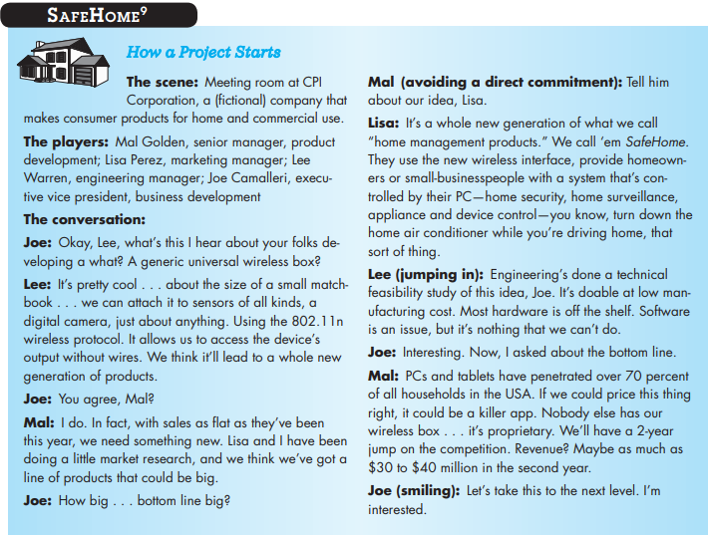

Slide 3
Software engineering
The IEEE [IEE93a] has developed the following definition for software engineering: Software Engineering :
(1) The application of a systematic, disciplined, quantifiable approach to the development, operation, and maintenance of software; that is, the application of engineering to software.
(2) The study of approaches as in (1).

Slide 4
stakeholder
A stakeholder is anyone who has a stake in the successful outcome of the project—business managers, end users, software engineers, support people, etc.

Slide 5
Software Engineering - a Layered Technology
The tools provide automated or
semi-automated support for the process and the methods
<<CASE tools>>
The methods provide the technical how-to's for building software.
tools
methods
process
a “quality” focus
Software Engineering
Quality Software
Development
The glue that holds the technology layers together and enables rational and timely development of Quality computer software
<<Process defines a framework>>

Slide 6
Relationship between Process Model and Framework
tools
The roadmap
methods
process
Process Model(s)
a “quality” focus
Different strategies
Layered Technology
Process Framework
Details about raodmaps

Slide 7
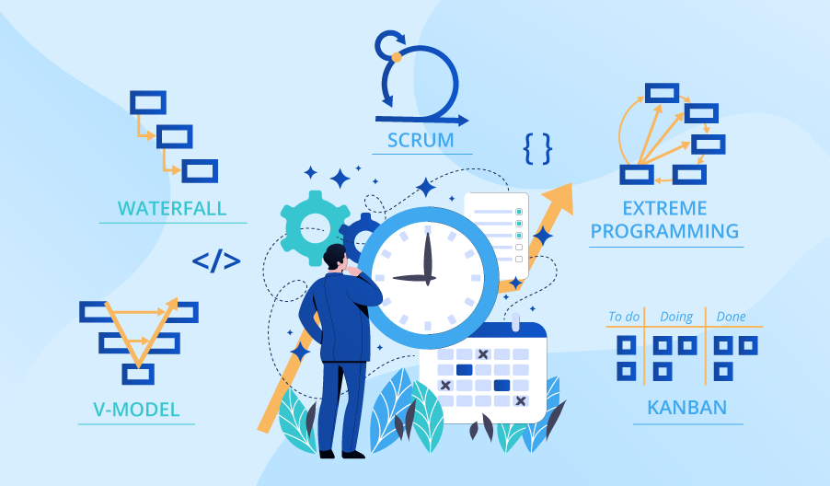

Slide 8
The process framework
Communication
Planning
Modeling
Construction
Deployment

Slide 9
The process framework-Communication
Before any technical work can commence, it is critically important to communicate and collaborate with the customer (and other stakeholders).
The intent is to understand stakeholders’ objectives for the project and to gather requirements that help define software features and functions.

Slide 10
The process framework-planning
Any complicated journey can be simplified if a map exists.
A software project is a complicated journey, and the planning activity creates a “map” that helps guide the team as it makes the journey.
The map—called a software project plan—defines the software engineering work by describing the technical tasks to be conducted, the risks that are likely, the resources that will be required, the work products to be produced, and a work schedule.

Slide 11
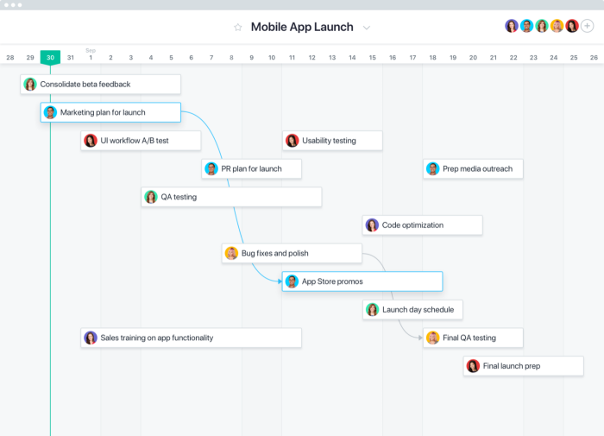
ASANA

Slide 12
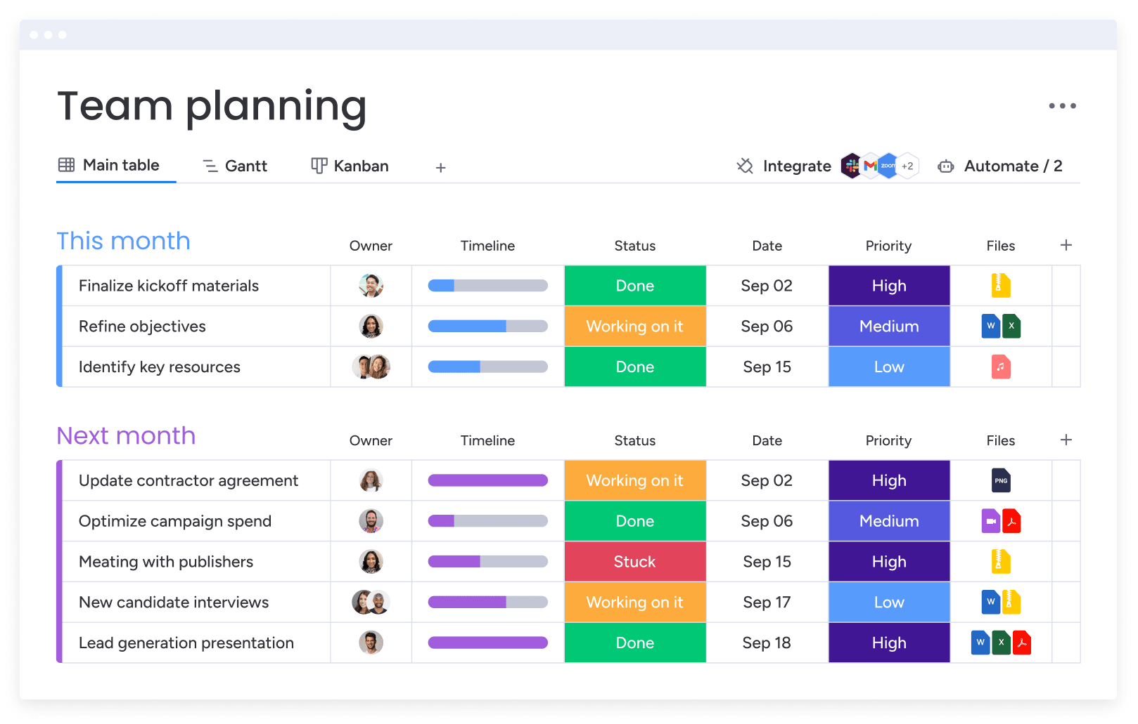
MONDAY.COM

Slide 13
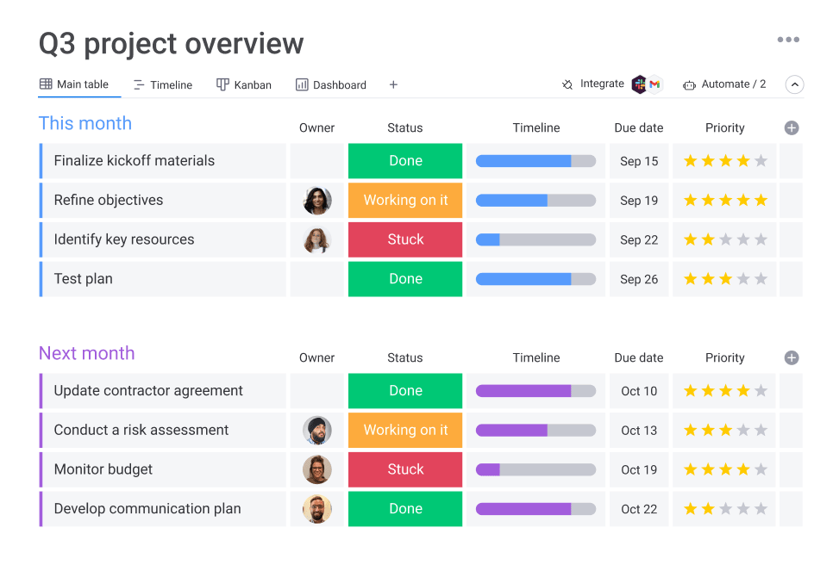

Slide 14
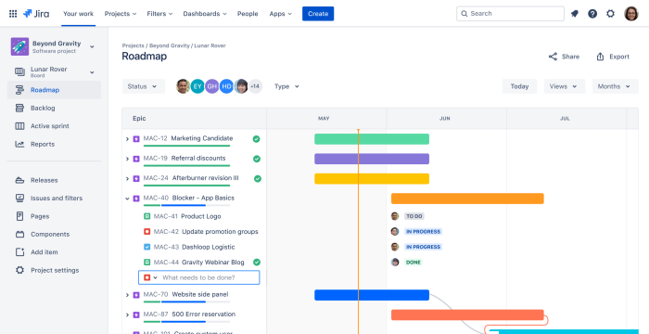

Slide 15
The process framework-modeling
Whether you’re a landscaper, a bridge builder, an aeronautical engineer, a carpenter, or an architect, you work with models every day.
You create a “sketch” of the thing so that you’ll understand the big picture—what it will look like architecturally, how the constituent parts fit together, and many other characteristics.
If required, you refine the sketch into greater and greater detail in an effort to better understand the problem and how you’re going to solve it.
A software engineer does the same thing by creating models to better understand software requirements and the design that will achieve those requirements.

Slide 16
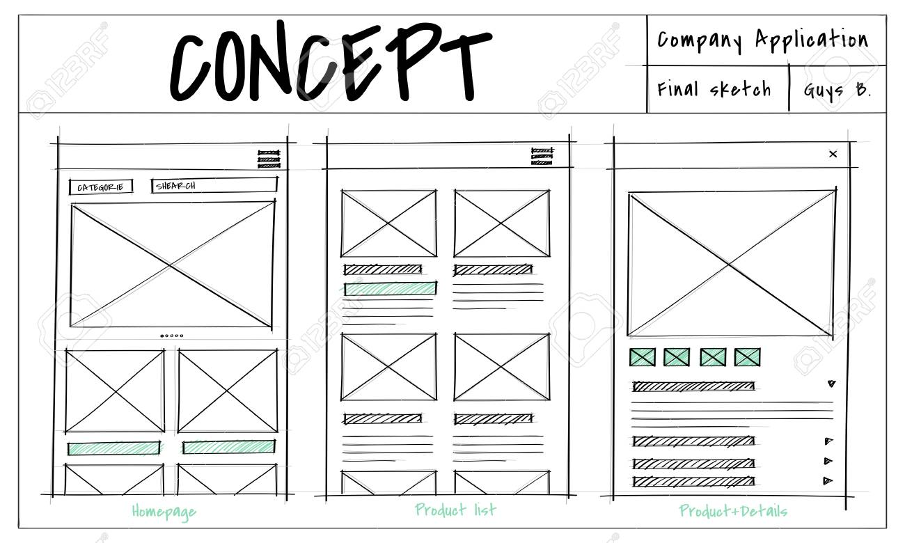

Slide 17
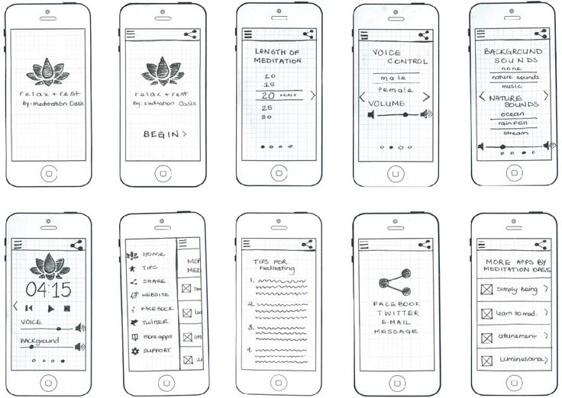

Slide 18
The process framework-construction
What you design must be built. This activity combines code generation (either manual or automated) and the testing that is required to uncover errors in the code.

Slide 19
The process framework-deployment
The software (as a complete entity or as a partially completed increment) is delivered to the customer who evaluates the delivered product and provides feedback based on the evaluation.
These five generic framework activities can be used during the development of small, simple programs, the creation of Web applications, and for the engineering of large, complex computer-based systems.

Slide 20
The Software Process
Communication
Project Initiation
Requirement gathering
Planning
Estimating
Scheduling
Tracking
Modeling
Analysis of requirements
Design
Construction
Code generation
Testing
Deployment
Delivery
Support
Feedback

Slide 21
Software Umbrella Terms
Programming Languages: Languages like Python, Java, C++, etc.
Development Environment: Tools and platforms used for coding, debugging, and testing like IDEs (Integrated Development Environments) and text editors.
Reusability management—Defines criteria for work product reuse (including software components) and establishes mechanisms to achieve reusable components.
Software Development Life Cycle (SDLC): The process followed in software development, including stages like planning, designing, coding, testing, and deployment.
Agile Development: An iterative approach to software development, emphasizing flexibility and customer collaboration.
Debugging: The process of identifying and fixing errors or bugs in code.
Deployment: The process of releasing software for users to access.
Maintenance: Activities involved in keeping software running smoothly after deployment, including updates and bug fixes.
Documentation: Writing and maintaining documentation to describe the software's functionality, architecture, and usage.
Quality Assurance (QA): Activities and processes to ensure that software meets quality standards and fulfills requirements.
Risk management—assesses risks that may affect the outcome of the project or the quality of the product.

Slide 22
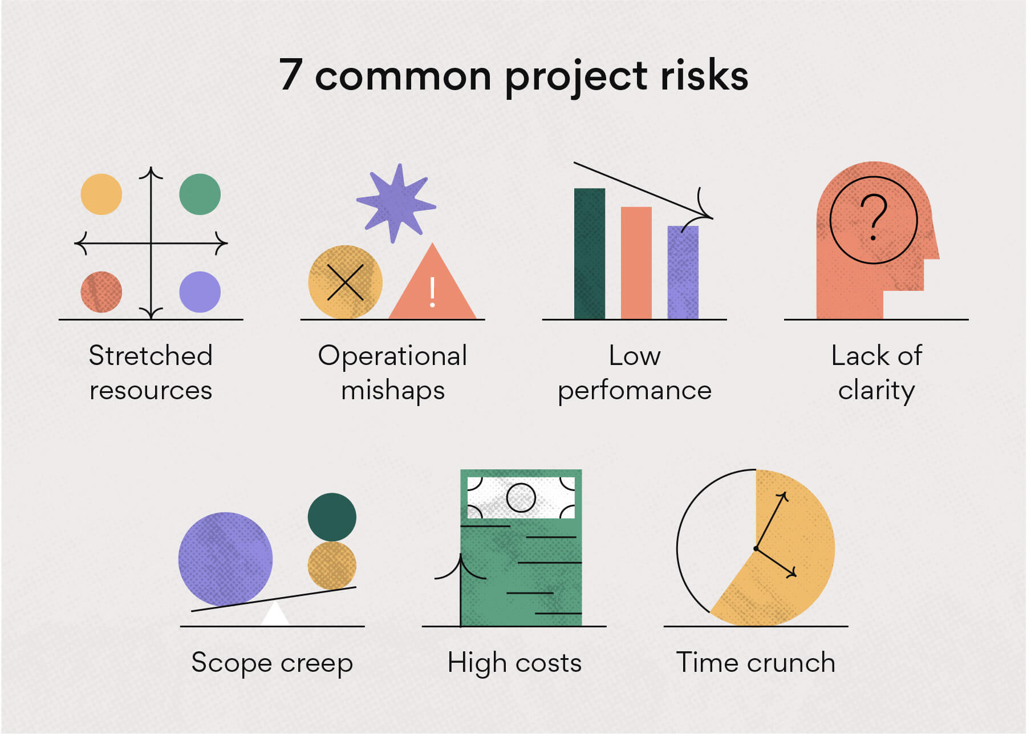

Slide 23
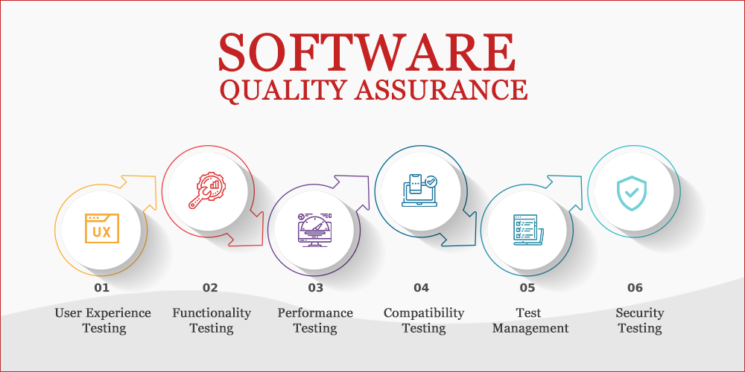
Umbrella activities
Software quality assurance—defines and conducts the activities required to ensure software quality. Technical reviews—assess software engineering work products in an effort to uncover and remove errors before they are propagated to the next activity.

Slide 24
Software engineering practice-the essence of practice
In the classic book, How to Solve It, written before modern computers existed, George Polya outlined the essence of problem solving , and consequently, the essence of software engineering practice:
Understand the problem (communication and analysis).
Plan a solution (modeling and software design).
Carry out the plan (code generation).
Examine the result for accuracy (testing and quality assurance).

Slide 25
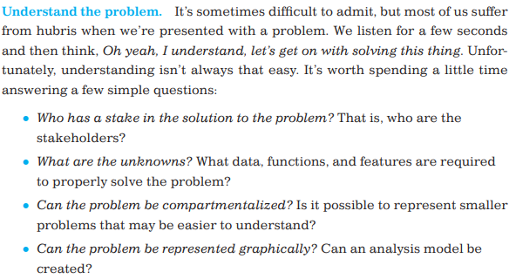
Software engineering practice-the essence of practice

Slide 26
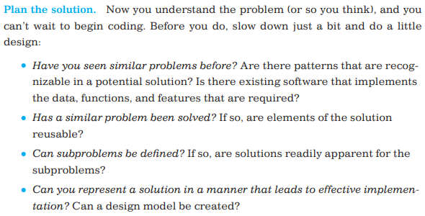
Software engineering practice-the essence of practice

Slide 27
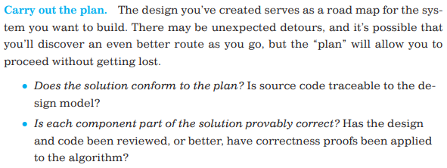
Software engineering practice-the essence of practice

Slide 28
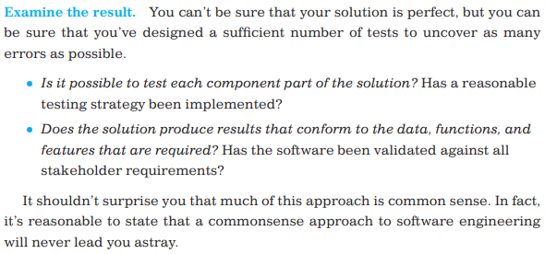
Software engineering practice-the essence of practice

Slide 29
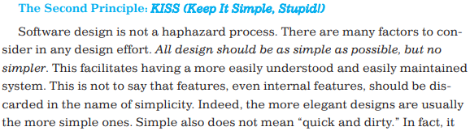
General principle
Keep it simple, stupid!-KISS

